Slide 1
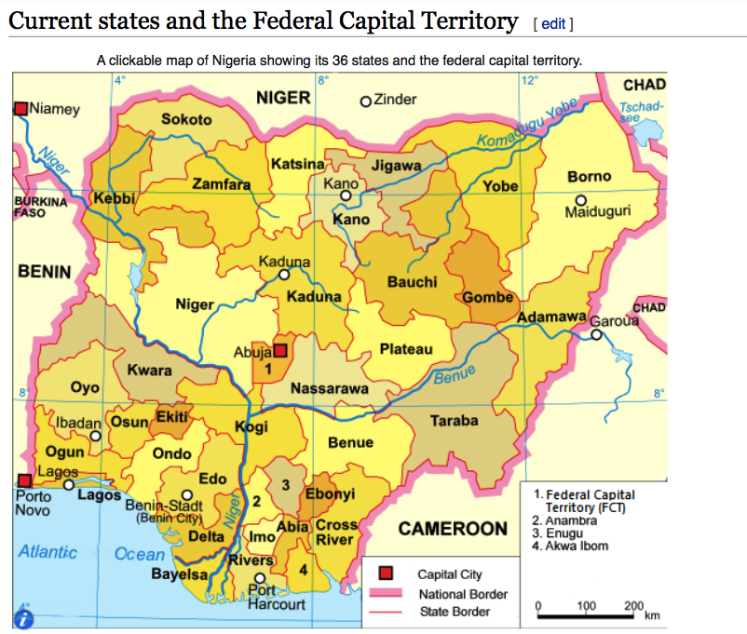


P
YOUR LOGO
YOUR SLOGAN HERE
Country Representative
Nigeria
Dr. Sarah Kayongo
Interview Panel:
Scott Desmarais
Tim Newman
Esther Ndungu
on 06/05/2020
Notes:
Photo credits: Getty images - The majestic ruins of the temple at Kom Ombo on the banks of the Nile River in Egypt

Slide 2


AGENDA
Which donors and implementation partners will you focus on and why?
What top priority programme areas and opportunities do you feel will be critical for VSO in the country/region?
What specific actions will you take to secure new programme opportunities and scale VSO’s programme portfolio?
SARAH KAYONGO_VSO_06052020
2

Slide 3
QUESTION 1
LIVELIHOODS
EDUCATION
health
Disaster Relief
Innovation
SARAH KAYONGO_ VSO_06052020

Slide 4
Which donors and implementation partners will you focus on and why?
Key Donors
USAID, USG, CDC UK AID EU World Bank GIZ, KfW GAVI | United Nations Agencies (23 agencies in Nigeria) Global Fund African Development Bank (ADB) OECD Bill & Melinda Gates Foundation
Implementing Partners: NGOs, Foundations, Government (State & Federal) and the Private Sector
Livelihoods | Microsoft, Dangote Foundation, Toni Olumelu Foundation, Ecco Bank, Microfinance Institutions, Agribusinesses e.g. Nestle, MARs, Rainforest Alliance, etc.
Health & Education | State & Federal Governments (all 36 states), Save the Children’s Fund, CARE, World Vision, MedShare, Clinton Foundation
Disaster Relief & Innovation | Catholic Relief Services, National Emergency Management Agency (NEMA), Growth and Employment (GEM) Project, World Bank Group funded project implemented by Nigerian Federal Ministry of Industry, Trade and Investment (FMITI)

Slide 5




Which donors and implementation partners will you focus on and why? Cont.
To deepen relationships with donor representatives on the ground. To seek ongoing advice on how to access funds, help with the proposal development and submission processes.
To share VSO’s strategy and other relevant information (assessment data, concepts) with donors on the ground, build awareness of VSO’s capacity and ability to respond to new project funding.
Meetings to present VSO’s programme updates may be required.
To inquire and seek clarity on available funding fit - cycles/pipeline, including proposal requirements, funding amounts, submission deadlines, and likely phasing of funding rounds or new initiatives (e.g. USAID’s “Feed the Future).
NOTE: ECHO funding requires extra surveillance because they will often allocate initial funding within 48 hours.

Slide 6
Recommendations
Which donors and implementation partners will you focus on and why? Cont.
While Nigeria’s GDP is close to $600 billion and it has the world’s 10th largest oil reserves, unfortunately, the economic fallout from Covid19 and subsequent drop in oil prices spell uncertainty for the country. https://www.statista.com/statistics/gross-domestic-product-gdp-growth-rate-in-nigeria/
With a burgeoning population of 178 million, wide income inequalities, and civil war in the N/E part of country, close to 78 million people live in poverty.
Government efforts are underway to diversify the economy and reduce the overdependence on oil revenue by investing in agriculture. These plans are expected to provide youth employment, reduce food insecurities and improve nutrition.
Hence, government is a viable partner for VSO’s livelihoods programs.
Theoretical Advance
Partners
Government, NGOs

Slide 7
Which donors and implementation partners will you focus on and why? Cont.
The oil & Gas sector will be a viable partner for CSR activities either through direct project sponsorships, employee matching gifts, PPPs, or events sponsorships
In January, 2020, Microsoft announced the “Carbon Negative” Campaign, the goal is for countries to plant one million trees. Partnering on such an initiative will create jobs for the youth, engage volunteers & provide income. a-healthy-society-requires-a-healthy-planet
Microsoft, IBM & Google have innovation hubs in Nigeria, I’d pursue partnerships to leverage technology to scale VSO’s work across all programs e.g. e-volunteering, designing cloud- based apps for remote based staff/volunteers & field workers to connect with farmers, education apps for the blind/deaf, children in refugee camps, skills training for youth and prisoners via mobile phones or radio programs and telehealth options with a network of healthcare providers.
Nigeria is home to some of richest individuals and philanthropists in Africa e.g. Dangote and Tony Olumelu Foundations – both fund health, education and other programs.
Partners
Corporations, Foundations, HNWi etc.

Slide 8
QUESTION 2
LIVELIHOODS
EDUCATION
health
Disaster Relief
Innovation
SARAH KAYONGO_ VSO_06052020

Slide 9
What top priority programme areas and opportunities do you feel will be critical for VSO in the country/region?
Livelihoods/Scale Agriculture
Fight food insecurities, poor nutrition and create jobs for Africa’s most populous country
Innovation in farming methods to scale production
Health
Build capacity to strengthen health systems at state level by managing spread and deadly effects of communicable diseases e.g. Covid19, Ebola. Key will be to work in consortium with health donors, UN agencies (WHO), GAVI & *MedShare, Bill and Melinda Gates foundation
Disaster Relief
Immediate relief such as cash transfers, food vouchers and deworming tablets to help fragile communities bounce back from setbacks caused by disasters
Build the resilience of communities to withstand shocks caused by: climate, civil unrest or health pandemics (Covid19, Ebola etc.)
Connect farmers to supply chains, finance, GAPs, markets
Livelihoods
(Scaling Agriculture)
Health
Disaster Relief
Innovation
*Cross cutting innovation across all programs through strategic partnerships

Slide 10

A case for A Disaster relief program
2. Health
1. Livelihoods
3. Education
Disaster Relief Fund/New Revenue streams
UN agencies can be a key source of funds during emergencies, particularly UN partners of WFP, UNHCR and UNICEF, with whom NGOs often work as implementing partners.
There are three key UN funding mechanisms that apply in emergencies, although experience shows they are currently not necessarily easy for NGOs to access, and can be very slow:
Central Emergency Response Fund (CERF) is available to UN agencies to support humanitarian response. NGOs cannot access funding directly but can be engaged as implementing partners of the UN agencies receiving CERF funding.
Emergency Response Funds (ERF) are funds made available to NGOs through OCHA to address critical gaps in humanitarian assistance. Management of ERFs varies from country to country.
Pooled/Common Humanitarian Funds (CHF) are funds given by donors, that are not earmarked for any specific purpose and can be used flexibly. Responsibility for allocating
SARAH KAYONGO_ VSO_06052020

Slide 11
Useful resources for Disaster relief funding “Nigeria/UN COVID-19 BASKET FUND”
March 26, 2020
"Today, I am pleased to announce that the United States has made available nearly $274 million in emergency health and humanitarian funding,” U.S. Secretary of State Mike Pompeo said Thursday in a statement.”
https://www.voanews.com/usa/us-pledges
April 30, 2020
“U.K. pledges £1.65B to Gavi for the next 5 years
“The United Kingdom has pledged to donate the equivalent of £330 million ($410 million) a year to Gavi, the Vaccine Alliance, for the next five years.”
Source: Global Health Report
May 7, 2020
“The Aliko Dangote Foundation (ADF) has donated N1.5 billion ($3.8 million) to the ‘Nigeria/United Nations COVID-19 Basket Fund’ to boost the fight against the novel coronavirus disease.”
https://www.today.ng/news/Nigeria/aliko-dangote

Slide 12
QUESTION 3
LIVELIHOODS
EDUCATION
health
Disaster Relief
Innovation
What specific actions will you take to secure new programme opportunities and scale VSO’s programme portfolio?

Slide 13
Scaling Strategy: Diverse Funding Sources & Activities
Approach I
Approach II
Approach III
Approach IV
Proposal writing & reporting on
Existing one & new pipeline
Public Private Partnerships: NGOs Government, State and Federal levels
Corporate Fundraising/Foundation/HNW/MFI/Financial Inst.
Public Relations, Events, Social Media, Celebrity Endorsements
Global Fund/Covid19 relief (Health).
USAID – “Feed the Future” (Agriculture)
African Development Bank fund (Covid19 fund).
Bill & Melinda Gates Foundation: National Polio eradication plan.
Pursue partnerships with lead UN Agencies.
Leverage the capacity to strengthen health systems at state & govt. levels.
Push reform agenda & PPPs for inclusive education e.g. *(radio education & “Unlocking talent”).
NGO joint proposal partnerships for disaster relief, education, health & other programs.
Leverage innovation hubs within Microsoft to design cloud-based apps that will boost VSO’s ability to scale program interventions remotely & in real time.
*Initiate a professional consulting unit within the volunteer program.
Employee Matching funds
Financial linkages with banks
Target HNWI i.e. Dangote.
Social media fundraising campaigns (gofundme.com) also as a tool to influence policy reform i.e. disabled rights, prisoners & elderly.
Events: “Virtual runs, walks, webinars, etc.
Initiate series of evidence - based workshops on inclusion - showcasing VSO’s 60 years’ use of volunteers to fight poverty
June – September 2020
October – Jan 2021
Feb 2021 – May 2021
June - September 2021

Slide 14
Scaling Strategy: Multi-Partner Approach (Accountability)
Private Sector, HNWi, Social Media & PR
Government NGOs &
Foundations
Donor Agencies
1/3 of the time will be spent on institutional donor portfolio pipeline and new proposal development to new donor partners.
1/3 of the time will be dedicated to engaging government ministries for reform policies and strategic partnerships. Half of this time will be dedicated to state level partnerships in all 36 states beginning with most vulnerable states (Sokoto, Borno and others).
The final third will be dedicated to systematic cultivation of the private sector: Oil & gas, manufacturing, Telecom, Banking, HNWi, etc. with the aim of forging public private partnerships that align with their CSR and VSO’ program needs.
Innovation will be a crosscutting agenda for all program/partnership effort.s

Slide 15
VSO Nigeria – Vision 2030
Livelihoods
Education
Health
Disaster Relief
INNOVATION

Slide 16

THANK YOU
SARAH KAYONGO_VSO_06052020
Notes:
Photo credit: Baskets made by women’s savings group in Rwanda

